Slide 1

UNIVERSITY INSTITUTE OF ENGINEERING
COMPUTER SCIENCE ENGINEERING
Bachelor of Engineering
Design and Analysis of Algorithms(CST-302/ITT-302
Er. Snigdha Luthra(E8302)
Topic: Introduction to Floyd warshall and Sollin algorithm
DISCOVER . LEARN . EMPOWER

Slide 2
Learning Objectives & Outcomes
Objective:
To understand meaning of Floyd warshall and Sollin algorithm
Outcome:
Student will understand the meaning of Floyd warshall and Sollin algorithm

Slide 3
Floyd warshall Algorithm
Floyd Warshall Algorithm is a famous algorithm.
It is used to solve All Pairs Shortest Path Problem.
It computes the shortest path between every pair of vertices of the given graph.
Floyd Warshall Algorithm is an example of dynamic programming approach

Slide 4
Advantages-
Floyd Warshall Algorithm has the following main advantages-
It is extremely simple.
It is easy to implement.

Slide 5
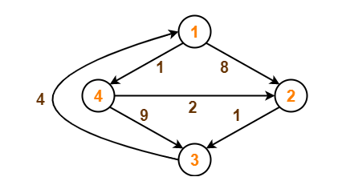
Example
Consider the following directed weighted graph-

Slide 6
Step-01:
Remove all the self loops and parallel edges (keeping the lowest weight edge) from the graph.
In the given graph, there are neither self edges nor parallel edges.
Step-02:
Write the initial distance matrix.
It represents the distance between every pair of vertices in the form of given weights.
For diagonal elements (representing self-loops), distance value = 0.
For vertices having a direct edge between them, distance value = weight of that edge.
For vertices having no direct edge between them, distance value = ∞.

Slide 7
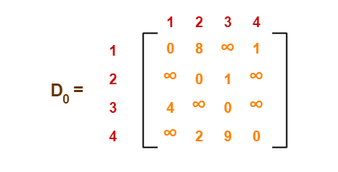
Initial distance matrix for the given graph is-
Step-03:
Using Floyd Warshall Algorithm, write the following 4 matrices-

Slide 8
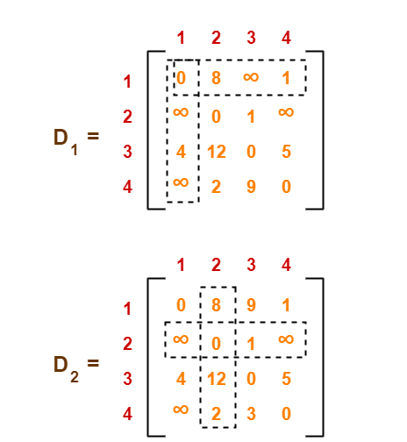

Slide 9
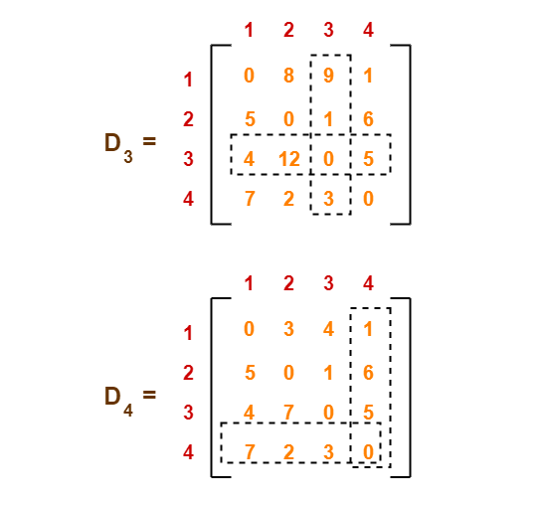

Slide 10
Sollin's Algorithm
1)Sollin's algorithm is a hybrid of Kruskal's and Prim's algorithm.
2)In Sollin's algorithm, we maintain a collection of nodes N1,N2,… and adds arcs to this collection, a technique borrowed from Kruskal's algorithm.
3)We also add minimum cost arcs at every iteration, a technique borrowed from Prim.
4)It's important to note that this algorithm requires all arc costs to be distinct, but Boruvka has said "If we measure distances, we can assume that they are all different.
5)Whether distance from Brno to Breclaw is 50 km or 50 km and 1 cm is a matter of conjecture."

Slide 11
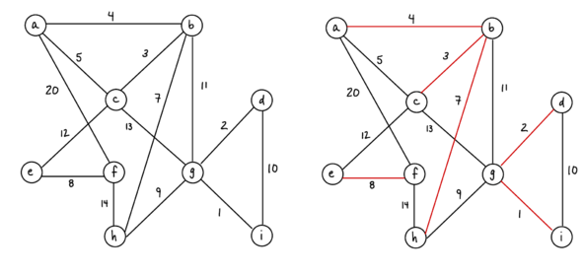
Example

Slide 12
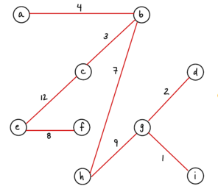
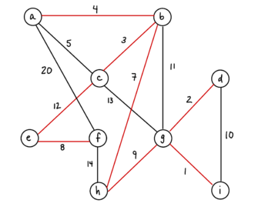
Example

Slide 13
REFERENCES
Text books:
Cormen, Leiserson, Rivest, Stein, “Introduction to Algorithms”, Prentice Hall of India, 3rd edition 2012. problem, Graph coloring.
Websites:
https://www.javatpoint.com/bellman-ford-algorithm
https://www.javatpoint.com/floyd-warshall-algorithm

Slide 14
THANK YOU

